Slide 1


Credit Card Default Prediction: A Supervised Learning Approach
By: PRIYA DUTTA
PGPDSBA.O.SEP23.C

Slide 2

CONTENT
3 | BUSINESS PROBLEM STATEMENT
5 | NEED FOR STUDY
9 | MODELLING APPROACH
6 | FINAL MODEL SELECTION
7 | INSIGHTS & RECOMMENDATIONS

Slide 3

PROBLEM STATEMENT
This business problem is focused on a credit card company aiming to predict customer default risk using a supervised learning model.
Objective: Predict customer defaults (i.e., will the customer pay or not).
Data: Includes various customer-related variables such as credit account information, purchasing behavior, and delinquency records.
Goal: Develop a model to assess customer risk and determine credit exposure.

Slide 4

BUSINESS PROBLEM UNDERSTANDING
Credit card companies face significant financial risks due to customer defaults. The inability to accurately predict which customers are likely to default can lead to considerable financial losses.
Risk Assessment
PD Modelling
Probability of Default (PD) models help understand how much credit is at risk.
Predicting defaults is critical to managing credit exposure
Business Impact
Ensuring efficient lending processes and credit approvals, particularly for high-risk customers

Slide 5
NEED FOR STUDY
Reduce Financial Losses: Identify potential defaulters early.
Improve Credit Risk Management: Refine risk assessment strategies.
Enhance Customer Engagement: Proactively support high-risk customers.
Ensure Regulatory Compliance: Align with industry risk management standards.

Slide 6
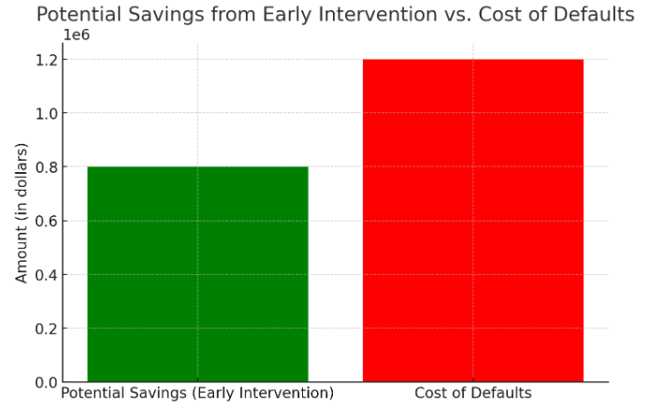

Slide 7
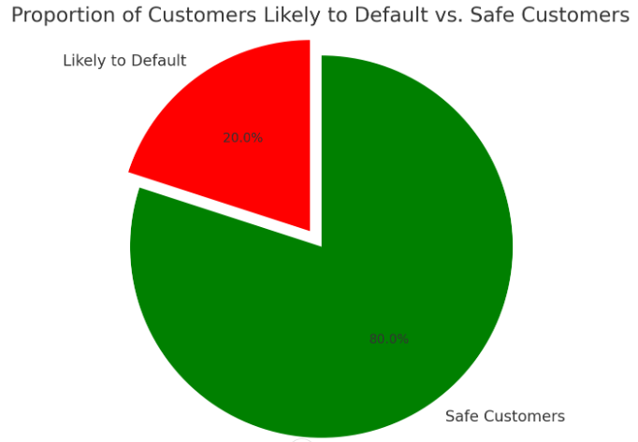

Slide 8
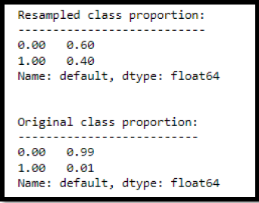
HANDLING IMBALANCE DATA USING SMOTE
Balance the class distribution by generating synthetic examples for the minority class.
Create synthetic data points between existing minority samples rather than just duplicating them, improving model generalization.
Benefits of SMOTE: Reduces bias toward the majority class. Improves recall for the minority class. Helps the model learn a better decision boundary.

Slide 9
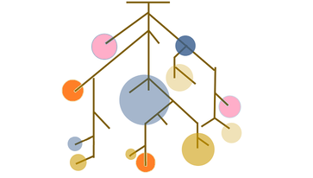




PREDICTIVE MODELING APPROACHED
RANDOM FOREST CLASSIFIER
A robust, non-linear model that handles overfitting and provides insights into feature importance.
Bagging with Random Forest as Base Estimator
Ensemble technique to reduce variance and increase model stability.
LOGISTIC REGRESSION
ADA BOOSTING
Simple, interpretable, and effective for baseline classification.
Focuses on learning from misclassified cases by assigning more weight to them.
Gradient Boosting
A sequential ensemble model focused on reducing both bias and variance, highly effective in dealing with complex relationships.

Slide 10
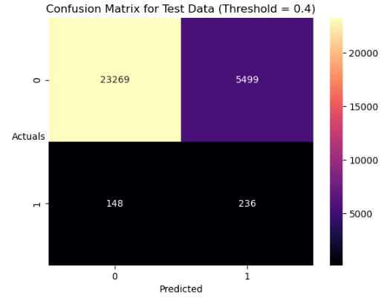
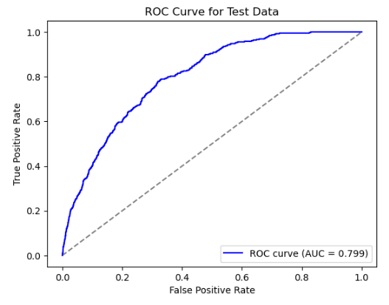

Slide 11
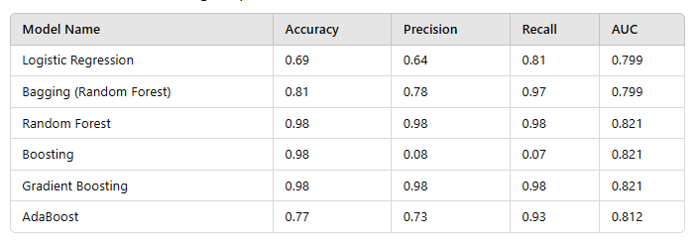
MODEL COMPARISON

Slide 12
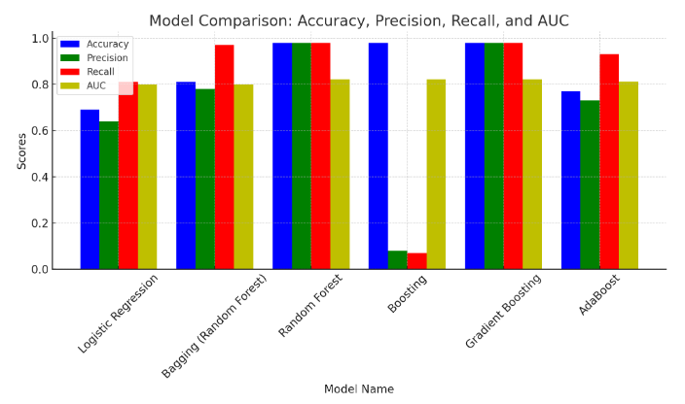

Slide 13
MODEL TUNING APPLIED
Hyperparameter Tuning was performed to enhance performance:
Random Forest: Tuned number of trees and maximum depth to balance bias-variance trade-off.
Bagging: Adjusted the number of estimators and bootstrapping samples.
Boosting Models: Adjusted learning rate, number of estimators, and maximum depth to avoid overfitting.

Slide 14
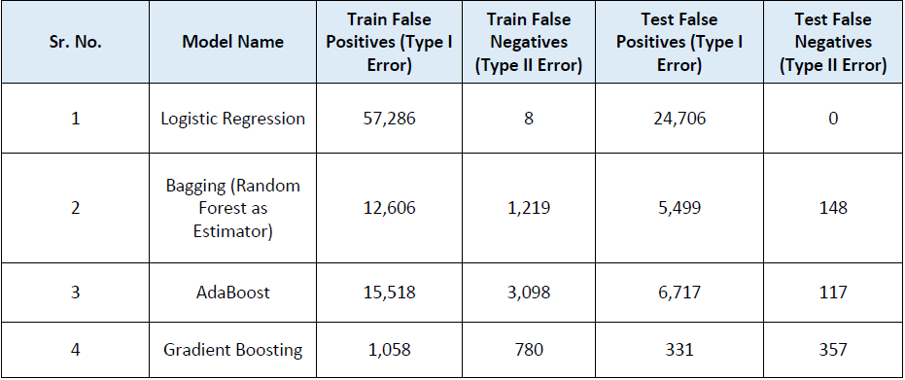
Correlation with the Problem

Slide 15
Final Model Selection
Bagging with Random Forest Classifier was selected as the best-fit modelbased on:
Balanced Accuracy: Reasonably high test accuracy (81%) while maintaining a strong train accuracy (88%).
Generalization Capability: Performs well on unseen data, with minimal overfitting compared to other models.
Low Type II Error: The model successfully identifies most of the high-risk (default) customers, minimizing potential losses.
Stability: Bagging helps reduce variance, making it more robust in the presence of outliers and noise.

Slide 16
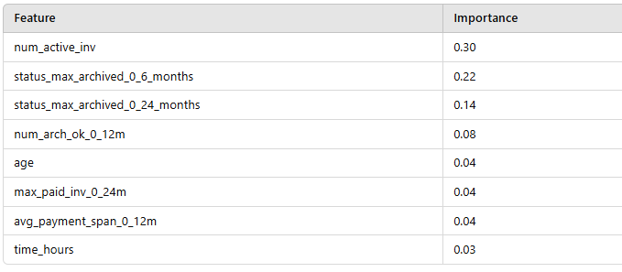
Importance Feature
Use this for a photo caption.

Slide 17
INSIGHTS AND RECOMMENDATION
Actionable Insight: Bagging with Random Forest allows early identification of high-risk customers.
Business Impact: Lower default rates, optimized credit limits, better customer segmentation.
Automated Risk Scoring
Threshold-Based Credit Approvals
Segmented Credit Offerings
Proactive Loan Restructuring
Automated Alerts & Reminders
Continuous Model Improvement

Slide 18
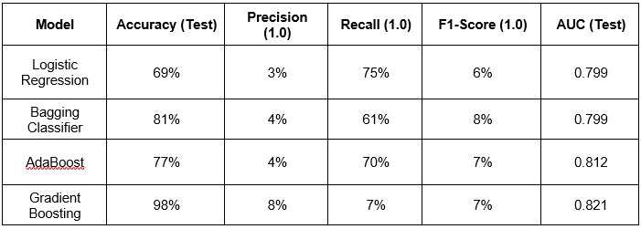
Accuracy: Achieves 81% on the test set, which is the highest among the models excluding Gradient Boosting.
F1-Score (1.0): While still low at 8%, it's slightly better than Logistic Regression and AdaBoost.

Slide 19


